Slide 1
API Automations for the Security Engineer
Tales of an API Consumer

Slide 2

# whoami
Brett “draztick” Jenson
Team Lead for Penetration Testing (Red Team Lead)
Wellstar Health System
Upcoming APISEC University Instructor
@draztick@infosec.exchange

Slide 3
Disclaimer
The opinions and views expressed in this presentation are my own and do not reflect the views of Wellstar Health System, affiliates, or other employees.

Slide 4
Background

Slide 5
Where My API Journey Began…
Touched on, briefly, in a training.
Handful of calls made via Postman
FAILED vendor professional services engagement.
Deliverable was NOT accurate
Expectations NOT met
Took matters into my own hands…
Step 1: Learned Python In-Depth
Step 1.1: Dissected unofficial Python Library
Step 1.2: Learn requests module
Step 2: Attack the Project

Slide 6
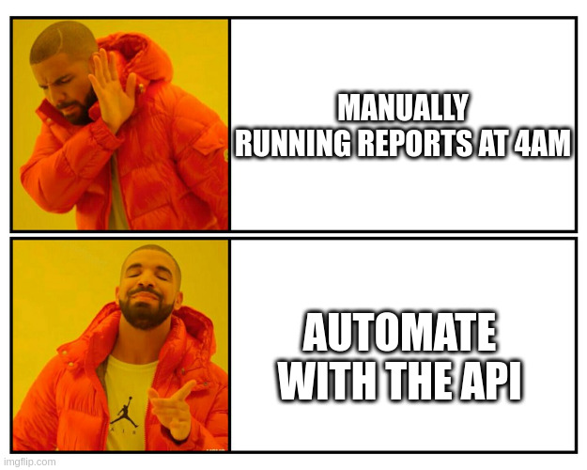
Project #1

Slide 7
Key Takeaways
Easiest way to learn is to have a project you are passionate about and attack it.
Fury > Passion
Don’t let not knowing get in your way.
Once you get started, it will be easy to continue.
Tons of free resources to get you off the ground, foundationally.

Slide 8
Project #2
The application in question had no file uploads for filters… only manual entry in the GUI
Very clunky and cumbersome…
3+ seconds per filter line added…
50 minutes per 1000 entries best case
Hostnames/IPs are worse…
“Tagger” command-line tool
CSV input
Single column of IP’s, hostnames, ranges supported
Dynamically generated a filter list (Python list containing dictionaries for each filter)
Created an asset group and/or tag based on filter list using the API

Slide 9
Key Takeaways
APIs can extend the capabilities and efficiency of your team tremendously.
Again, projects that you are passionate about will enhance the learning process.
Get good at reading Swagger Docs.

Slide 10
Project #3
Manual process to start
Run two reports
Download reports
Summarize information
Zip reports
Create email, boilerplate content
Insert summary into email
Format email
Attach zip file
Send to respective owner
12+ times…

Slide 11
Project #3
I’m lazy…
5 part problem
Reports
Zipping
Email
Multithreading
Owner Management
Time savings of ~2 hours per execution

Slide 12
Key Takeaways
Turns out, laziness can lead to learning opportunities too…
Do that project!! Even if it seems above you current capability level.
Multithreading is sick.

Slide 13
MS Teams Token to Impersonate a Teams User
Issue: Teams stored authentication token in cleartext.
CVE: ???
Microsoft didn’t think it was a big deal at the time.
My leadership wanted proof of exploitation…

Slide 14
MS Teams Token to Impersonating a Teams User
PoC Goal: “Harvest” a token and use it to read/write chats on behalf of that user.
Step 1: Use my token to get the API working.
Step 2: Use my bosses token to impersonate him.
Step 3: Automate to some degree.

Slide 15
MS Teams Token to Impersonating a Teams User
Step 1: Using my Token
Found an old REST API, whereas they preferred GraphQL API at the time.
Identified the correct endpoint…
200 Successful!​
MY conversations were all extracted.​
Grab Chat ID.​
Format: 19:XXXXXXXXXXXXXXXXX@something.something​
X’s = alphanumeric string distinct to chat​
Somethings relate to the TYPE of chat​
Meeting​
One on one​
Channel​
Etc.

Slide 16
MS Teams Token to Impersonating a Teams User
Step 1: Using my Token
Now to write…
POST + URI + Chat ID = 201 Created!​
Content in JSON format.​
{​
“content”:“Written Using API”,​
“messagetype”:”RichText/html”​
}​
Deleted because wrong Chat ID…

Slide 17
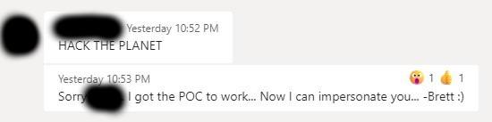
MS Teams Token to Impersonating a Teams User
Step 2: Using my bosses Token
Do THE READ first… Get CHAT ID…​
POST + URI + CORRECT CHAT ID = 201 Created!​
… But as my boss…

Slide 18

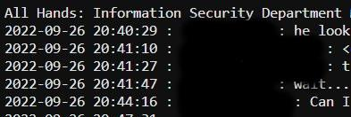
MS Teams Token to Impersonating a Teams User
Step 3: Automate

Slide 19
Key Takeaways
Strong foundation in using APIs as a consumer led me to exploitation of a known issue with no published PoC code.
Development background led me to create PoC code that never saw the light of day…
I had a ton of fun.

Slide 20


Coming Soon!
Introduction to Working with APIs
Brett Jenson
Offensive Security Practitioner
Instructor at APISEC University

Slide 21


Slide 22


Slide 23


Slide 24
Q&A

